Slide 1
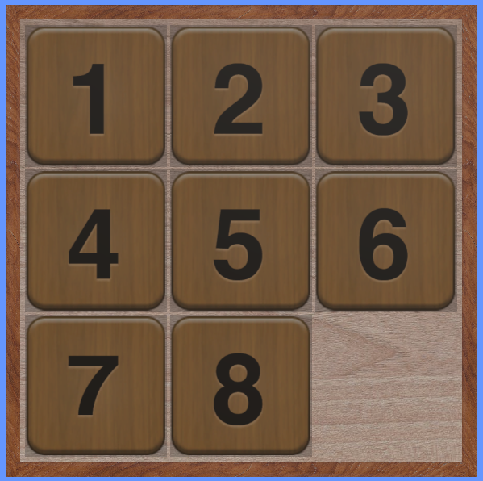

Slide 2
3

Slide 3
3
3

Slide 4
Blank Square

Slide 5
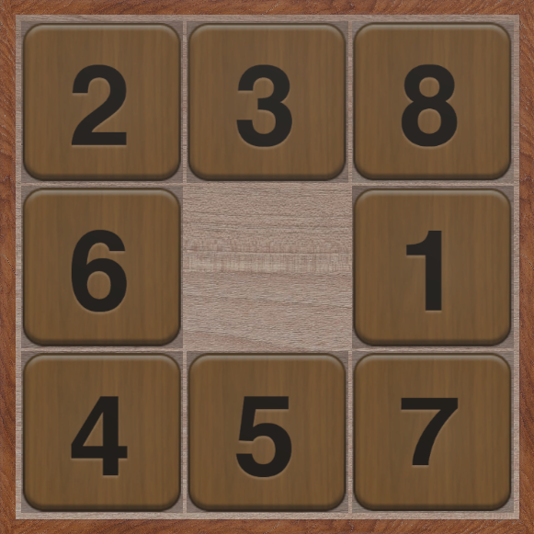

Slide 6
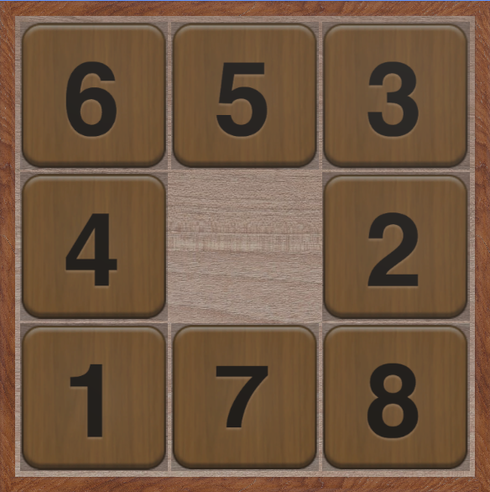
Initial State

Slide 7
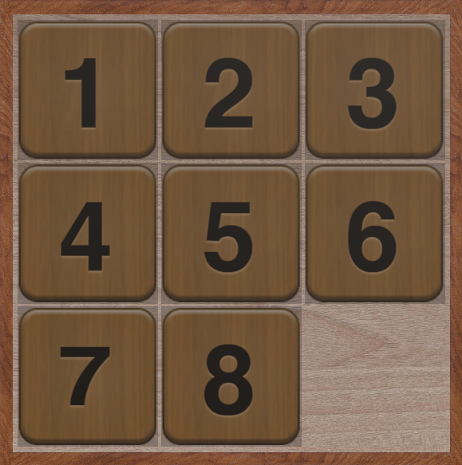
Initial State
Final/Goal State

Slide 9

Solvable problem states
= $\frac{9!}{2}=181,440$

Slide 10
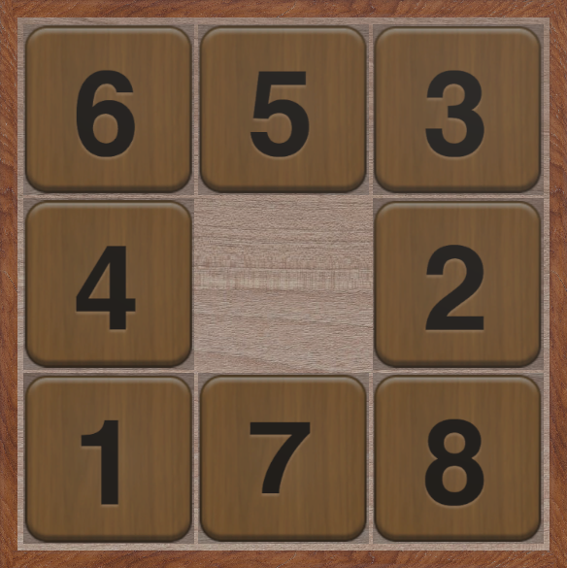

Slide 11
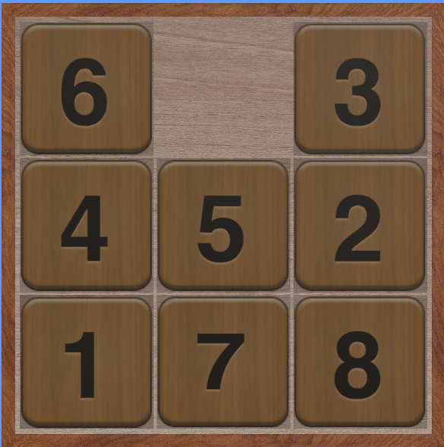

Slide 12
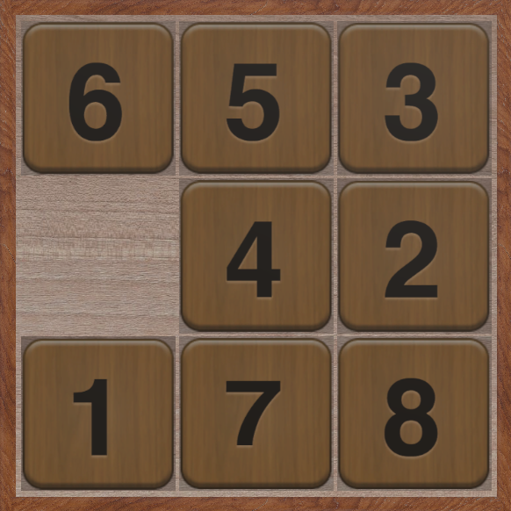

Slide 13
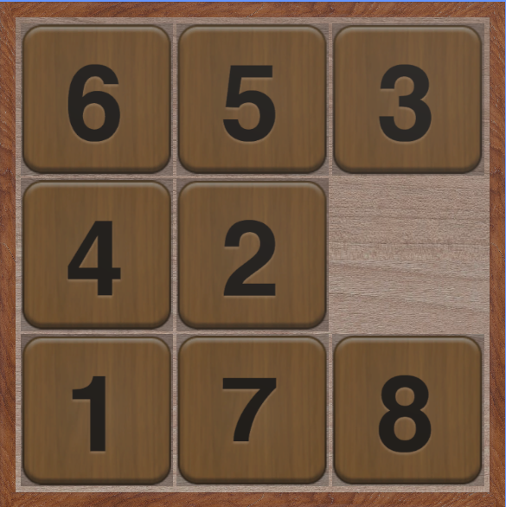

Slide 14
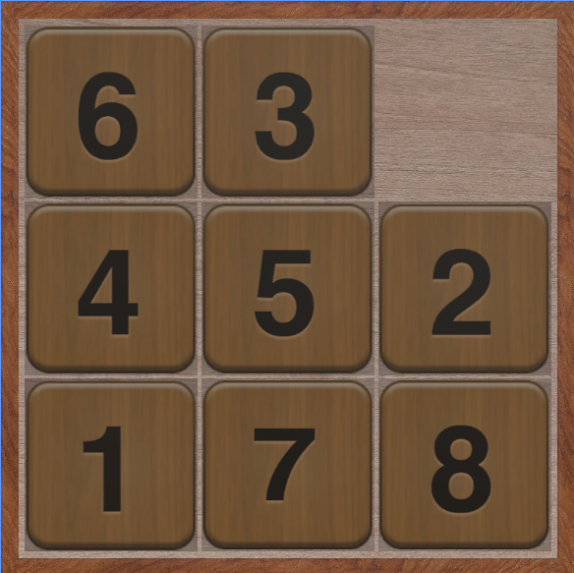

Slide 15
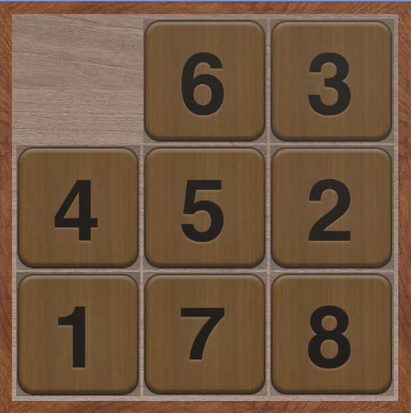

Slide 16
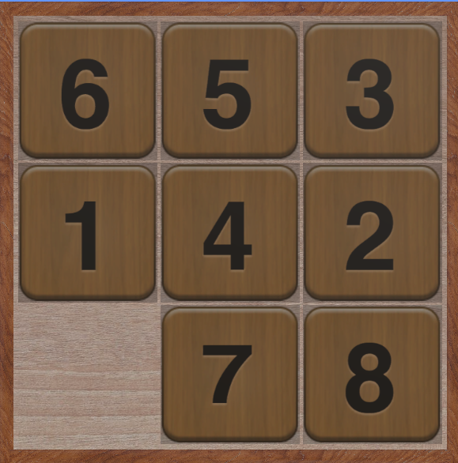

Slide 17
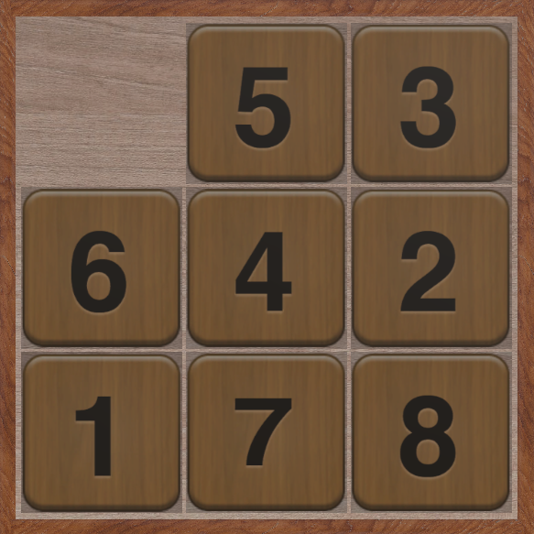

Slide 18
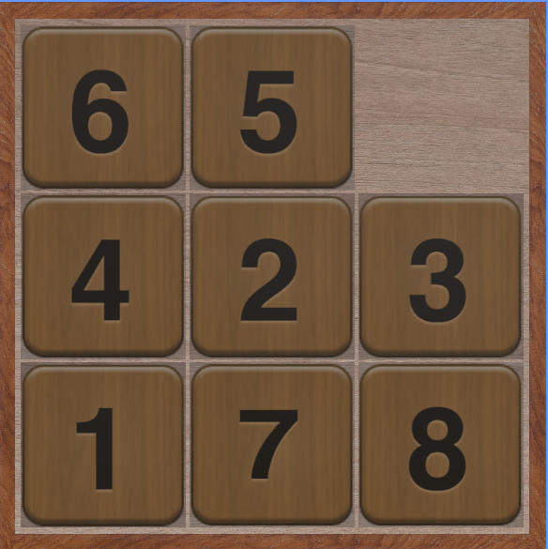

Slide 19
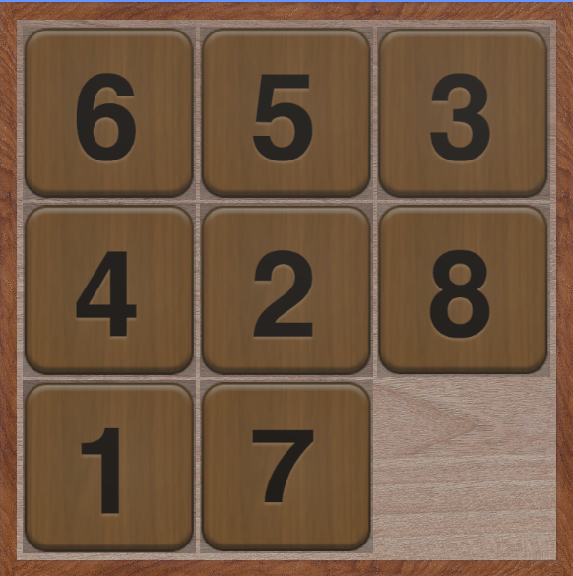

Slide 20
f = h + g
h (heuristic cost) is the estimated distance from the current configuration to the goal configuration, and g is the number of nodes traversed from the start configuration to the current configuration.
The objective of the search is to minimise the total cost f.

Slide 21
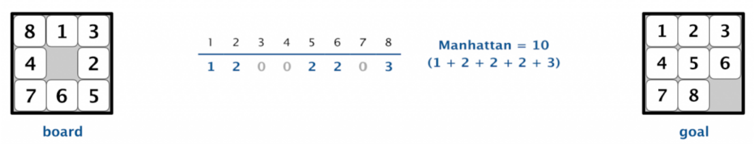
The diagram above shows the heuristic cost for a specific tile configuration based on the Manhattan Distance function.
The Manhattan distance heuristic is used for its simplicity and ability to estimate the number of moves required to bring a given puzzle state to the solution state. Manhattan distance is computed by the sum of the distances of each tile from where it should belong.

Slide 22
The diagram above shows the heuristic cost for a specific tile configuration based on the Manhattan Distance function.

Slide 24
0
1
2
3
4
5
6
7
8

Slide 25
0
1
2
3
4
5
6
7
8

Slide 26
0
1
2
3
4
5
6
7
8

Slide 27
0
1
2
Index 0: {1, 3}
3
4
5
6
7
8

Slide 28
0
1
2
3
4
5
6
7
8

Slide 29
0
1
2
3
4
5
6
7
8

Slide 30
0
1
2
3
4
5
6
7
8

Slide 31
0
1
2
Index 1: {0, 2, 4}
3
4
5
6
7
8

Slide 32
0
1
2
Index 0: {1, 3}
Index 1: {0, 2, 4}
Index 2: {1, 5}
Index 3: {4, 0, 6}
Index 4: {3, 5, 1, 7}
Index 5: {4, 2, 8}
Index 6: {7, 3}
Index 7: {6, 8, 4}
Index 8: {7, 5}
3
4
5
6
7
8

Slide 33
0
1
2
Index 0: {1, 3}
Index 1: {0, 2, 4}
Index 2: {1, 5}
Index 3: {4, 0, 6}
Index 4: {3, 5, 1, 7}
Index 5: {4, 2, 8}
Index 6: {7, 3}
Index 7: {6, 8, 4}
Index 8: {7, 5}
3
4
5
6
7
8

Slide 34
0
1
2
Index 0: {1, 3}
Index 1: {0, 2, 4}
Index 2: {1, 5}
Index 3: {4, 0, 6}
Index 4: {3, 5, 1, 7}
Index 5: {4, 2, 8}
Index 6: {7, 3}
Index 7: {6, 8, 4}
Index 8: {7, 5}
3
4
5
6
7
8

Slide 35
0
1
2
Index 0: {1, 3}
Index 1: {0, 2, 4}
Index 2: {1, 5}
Index 3: {4, 0, 6}
Index 4: {3, 5, 1, 7}
Index 5: {4, 2, 8}
Index 6: {7, 3}
Index 7: {6, 8, 4}
Index 8: {7, 5}
3
4
5
6
7
8

Slide 37
0
0
1
2
0
1
2
1
2
3
3
4
5
3
4
5
4
5
6
6
7
8
6
7
8
7
8

Slide 38
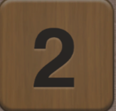
0
1
2
1
2
1
2
3
3
4
5
3
4
5
4
5
6
6
7
8
6
7
8
7
8

Slide 39
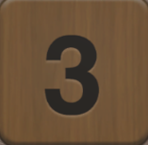
0
2
2
1
2
3
3
4
5
3
4
5
4
5
6
6
7
8
6
7
8
7
8

Slide 40
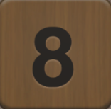
0
1
2
3
3
4
5
3
4
5
4
5
6
6
7
8
6
7
8
7
8

Slide 41
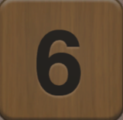
0
1
2
3
4
5
4
5
4
5
6
6
7
8
6
7
8
7
8

Slide 42
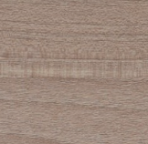
0
1
2
3
5
5
4
5
6
6
7
8
6
7
8
7
8

Slide 43
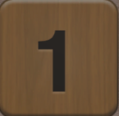
0
1
2
3
4
5
6
6
7
8
6
7
8
7
8

Slide 44
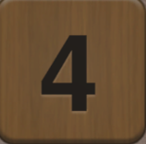
0
1
2
3
4
5
6
7
8
7
8
7
8

Slide 45
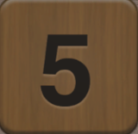
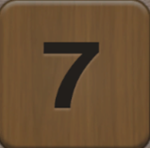
0
1
2
3
4
5
6
7
8

Slide 46
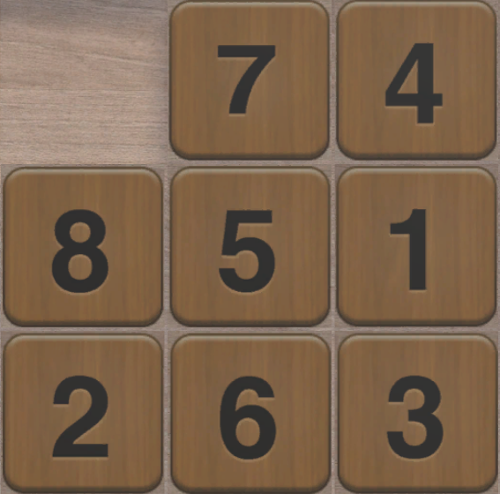
0
1
2
3
4
5
6
7
8

Slide 47
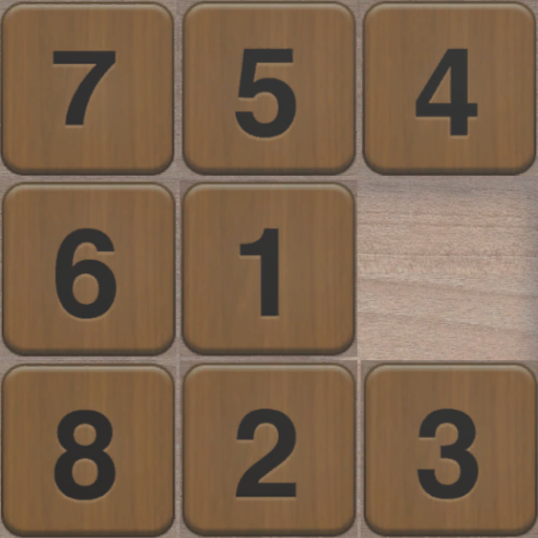
0
1
2
3
4
5
6
7
8

Slide 48
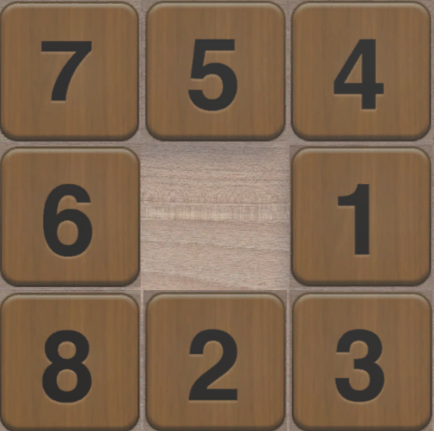
0
1
2
3
4
5
6
7
8

Slide 49
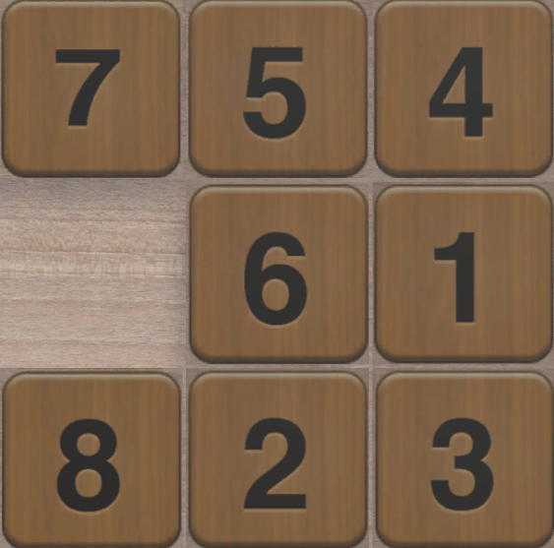
0
1
2
3
4
5
6
7
8

Slide 50
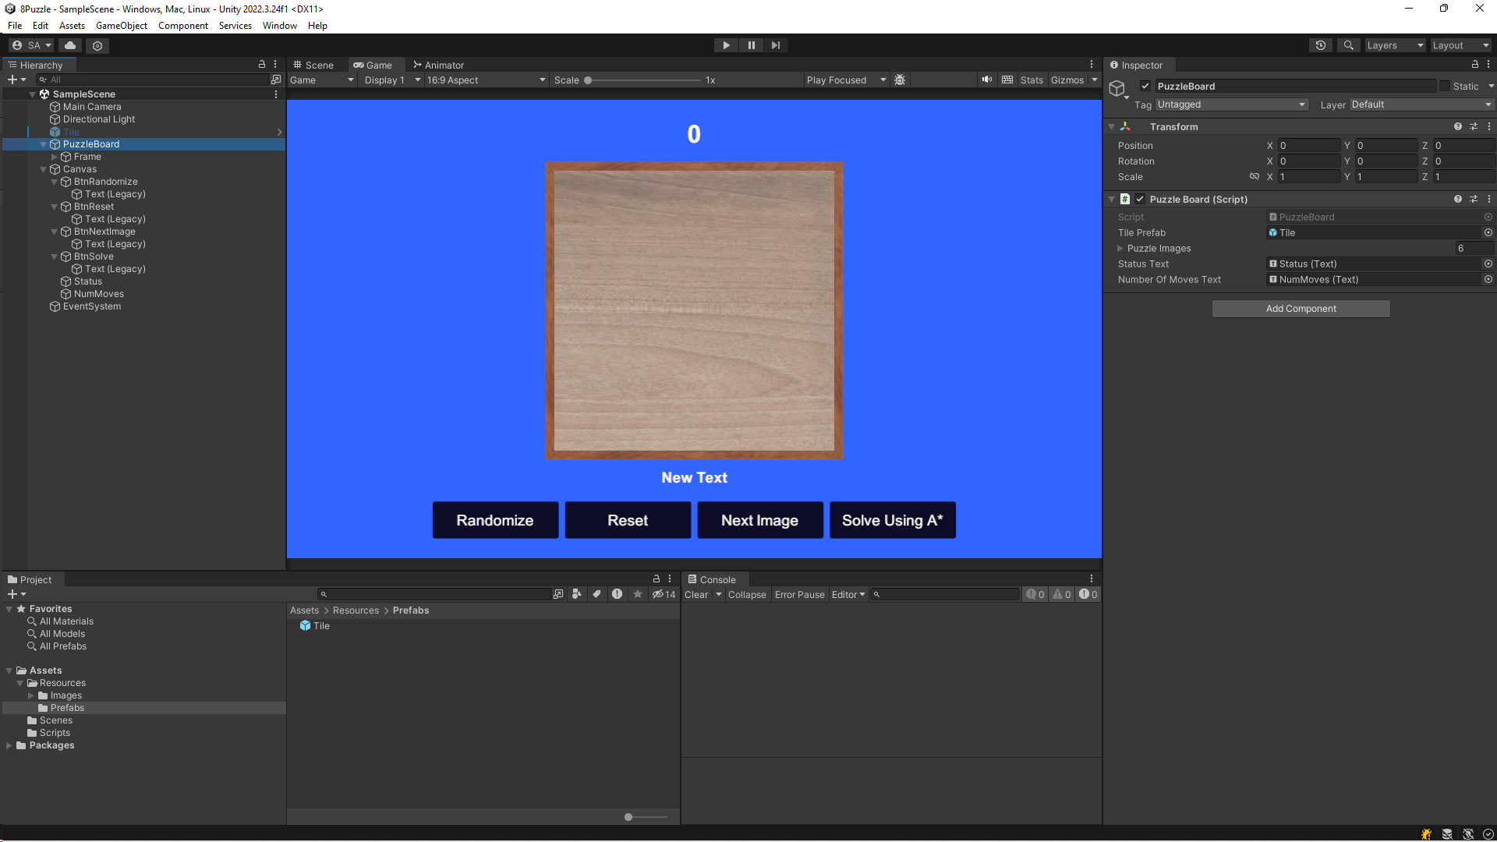

Slide 53
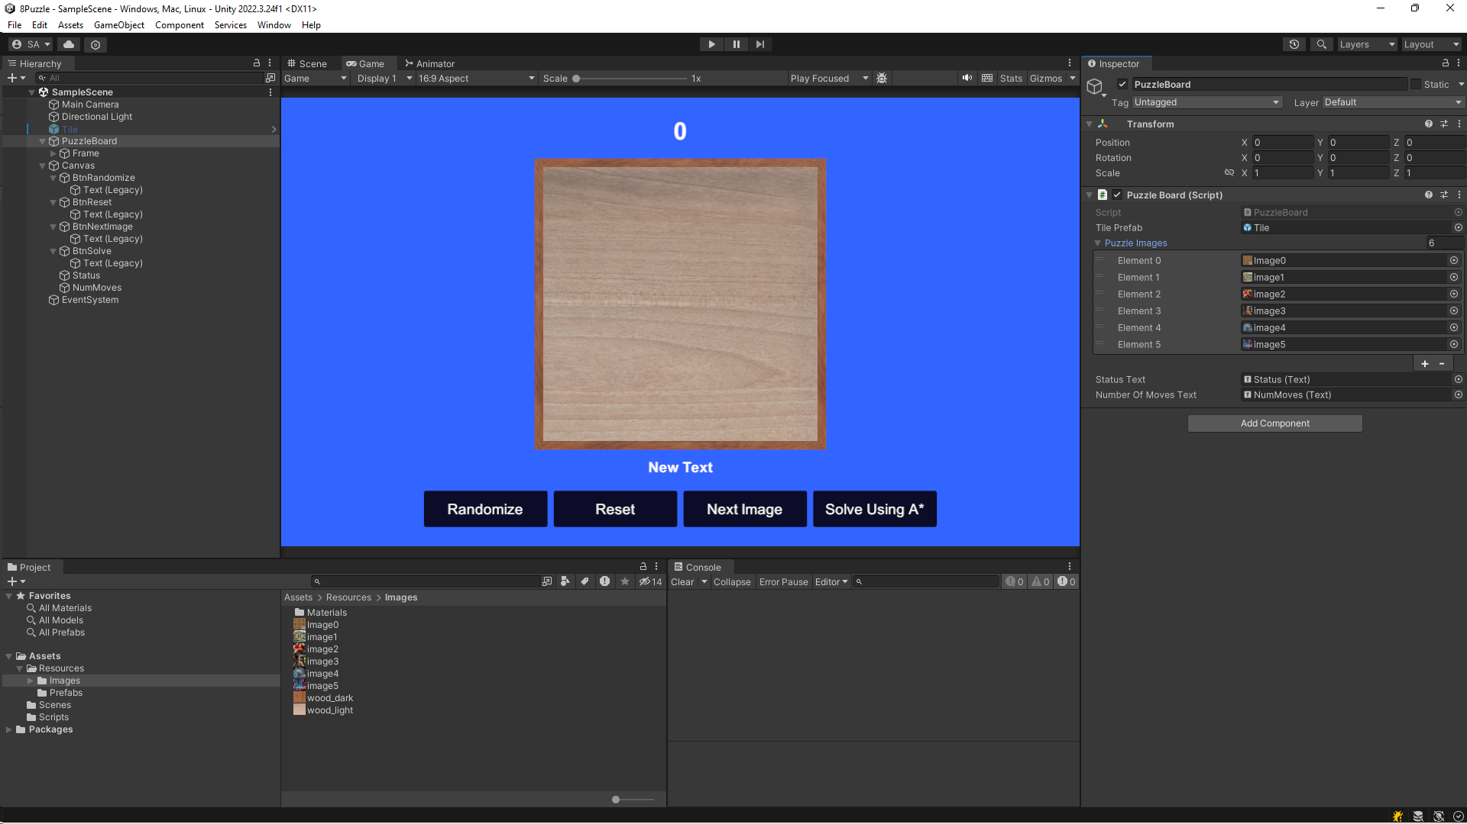

Slide 54
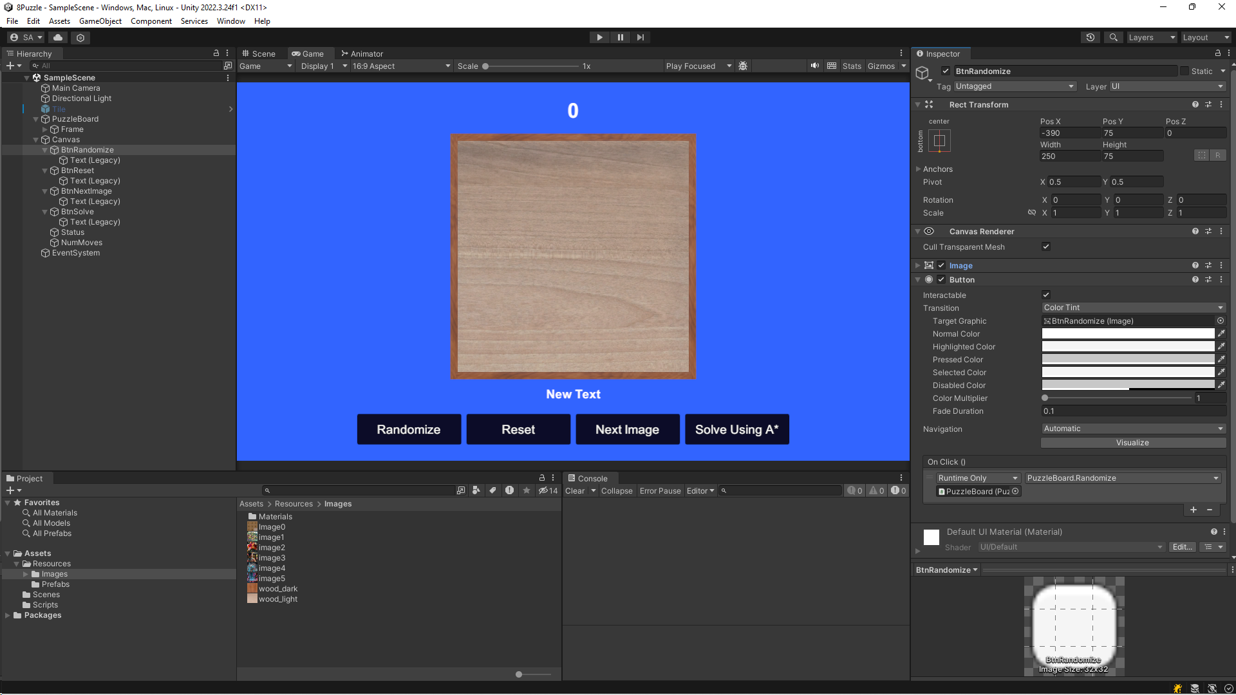

Slide 55


Slide 56


Slide 57
